Slide 1

Crowdfunding app
for education
Presented by
Karthick B, 1912067
Jesu Pandian, 1912063
Guided by: Rajesh Kumar S, Assistant Professor CSE

Slide 2
AGENDA
Abstract
Literature Survey
Empathy Map
Proposed Architecture
Modules
Experimental results
Analysis
Conclusion
Reference

Slide 3
Abstract
Poverty impact in education is maximum around 1.21 billion population living below the poverty line, peoples are stopping education due to poverty.
So a way to bring education in fast way that does not take so long is crowdfunding, Crowdfunding has emerged as a market-based solution to give frontline complex public service.
In there a small donation from various donors will light up a students life, but the cause is students cant go in search of donors, where it comes a public community through application.
The application helps uniting all donors and talented students together in a platform with helps a lot in their in education.
The application is designed in a way that the users can easily showcase their skills to the public that attracts more people to the community.
Integration of the application within an organization with org support will run the community in the balanced way.
Also the solution came with up built in wallet and security system which helps in easy fund trasnsaction which helps a lot in emergency fundraising.

Slide 4
Literature survey
Name | Author | Year
Duan Dynamic Strategies for Successful Online Crowdfunding | Zhuoxin Li & Jason A | 2014
Vast Crowdfunding in Action: How Institutional Logics Encourage and Constrain Affordance Perception | Claire Ingram, Robin Teigland and Emmanuelle | 2017
Crowdfunding Motivations: A Focus on Donors’ Perspectives,” Technological Forecasting and Social Change | Bagheri, Afsaneh, Chitsazan , Hasti, Ebrahimi, Ashkan | 2019
Empowering Education with Crowdfunding: The Role of Crowdfunded Resources and Crowd Screening | Chen Zhou, Manpreet Gill, Qiang Liu | 2021
Why Some School Districts Are Banning Teachers from Crowdfunding to Pay for Classroom Supplies | Cachero, Paulina | 2019

Slide 5
Name | Author | Year
Educational Crowdfunding and Student Performance: An Empirical Study,” Information Systems Research | Gao, Qiang, Lin, Mingfeng, Wu, D.J | 2021
Requests on Education Crowdfunding Site ‘Exceptionally High,’” Education Dive | Jacobson, Linda | 2018
Modeling Dynamics in Crowdfunding,” Marketing Science | Kim, Chul, Kannan, P.K., Trusov, Michael, Ordanini, Andrea | 2020
The Dynamics of Crowdfunding: An Exploratory Study” Journal of Business Venturing | Mollick, Ethan | 2014
Educational Crowdfunding and Student Performance: An Empirical Study,” Information Systems Research | Gao, Qiang, Lin, Mingfeng, Wu, D.J | 2021

Slide 6
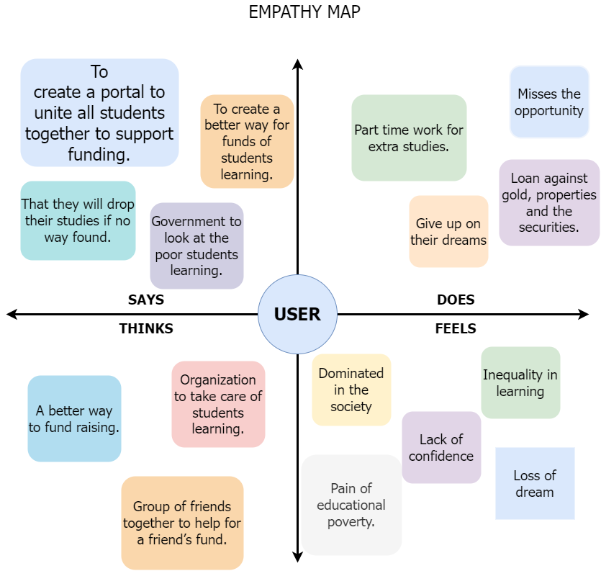
Empathy map

Slide 7
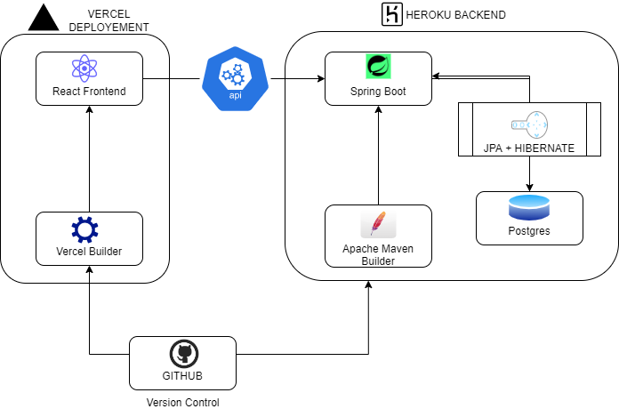
Proposed architecture
System architecture

Slide 8


Spring boot + react architecture
Spring Boot
React js
Uses the very lightweight POJO model when writing classes
Allows us to freely link modules and easily test them
Provides lot of security features.
JPA enables easy DB communication
Scalable
Component based development.
Huge community support
Virtual DOM enable fast re rendering of dom.
One way data binding helps in maintaining the data flow.
NPM gives lot library support.

Slide 9
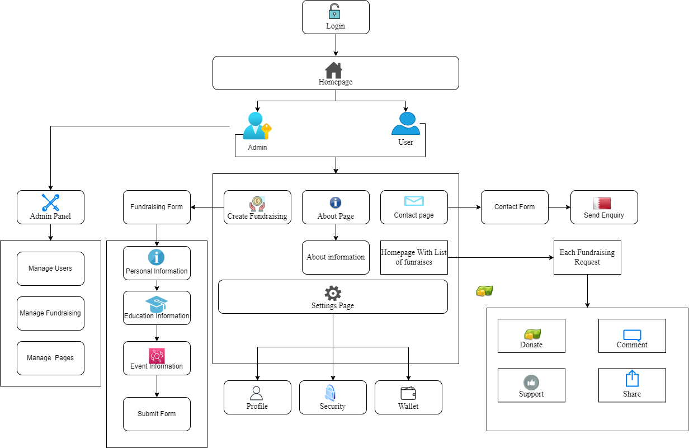
Application architecture

Slide 10
Admin ⚙️
Modules
Admin
User
Guest
User 👤
Guest 👥
Manage Users
Manage Fundraisers
Manage Pages in application
Profile Management
Wallet Management
Browse all active fundraising.
Add and withdraw cash with wallet
View Transactions
Vote for others fundraising
Donation to fundraising
Share to social media
Profile management
Browse all active fundraising.
Share to social media

Slide 11
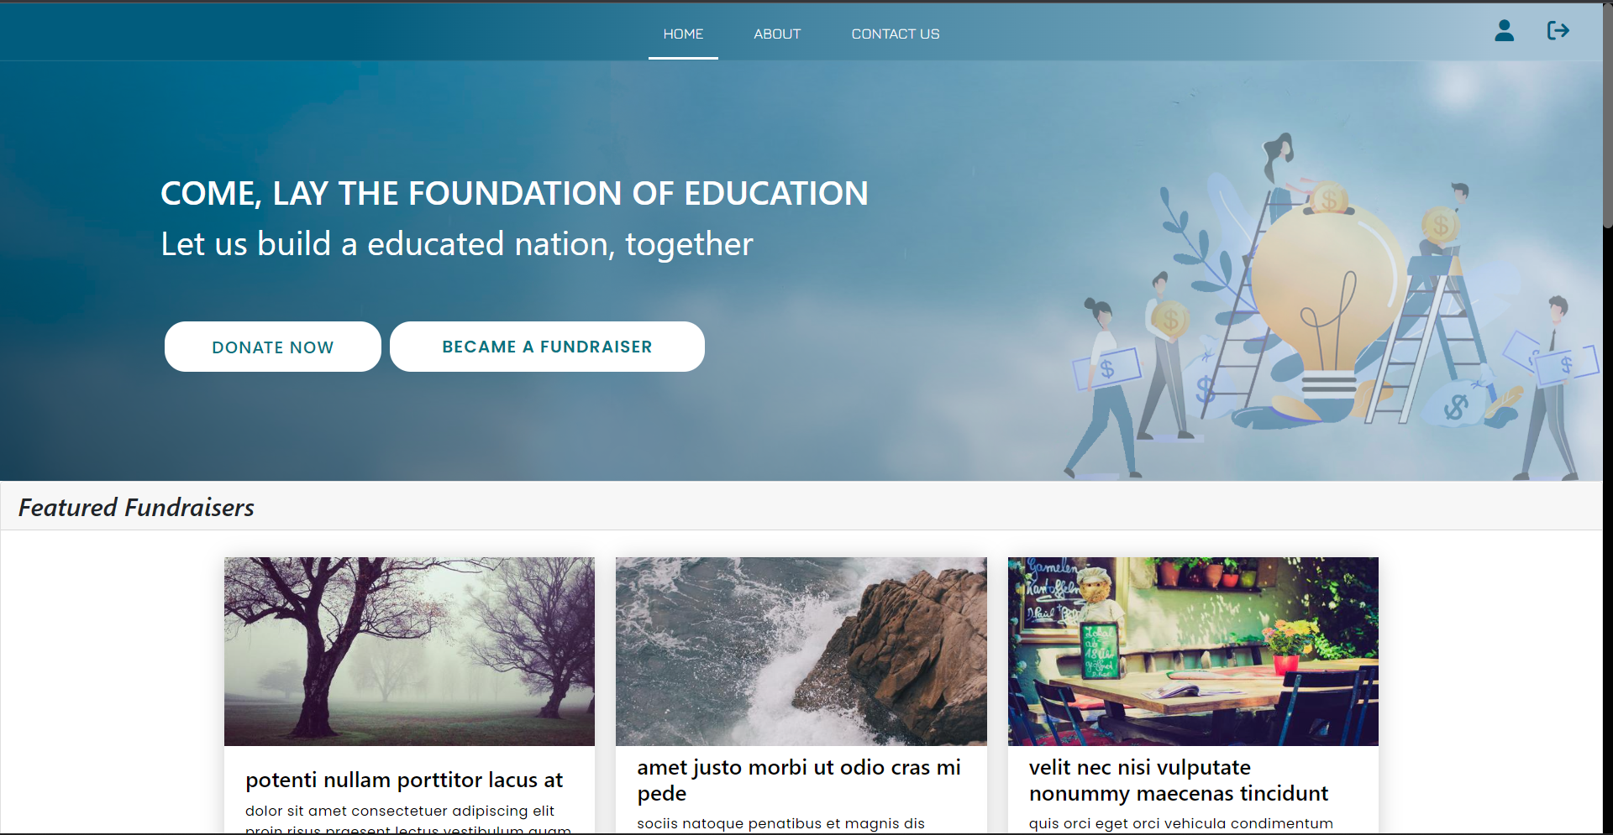
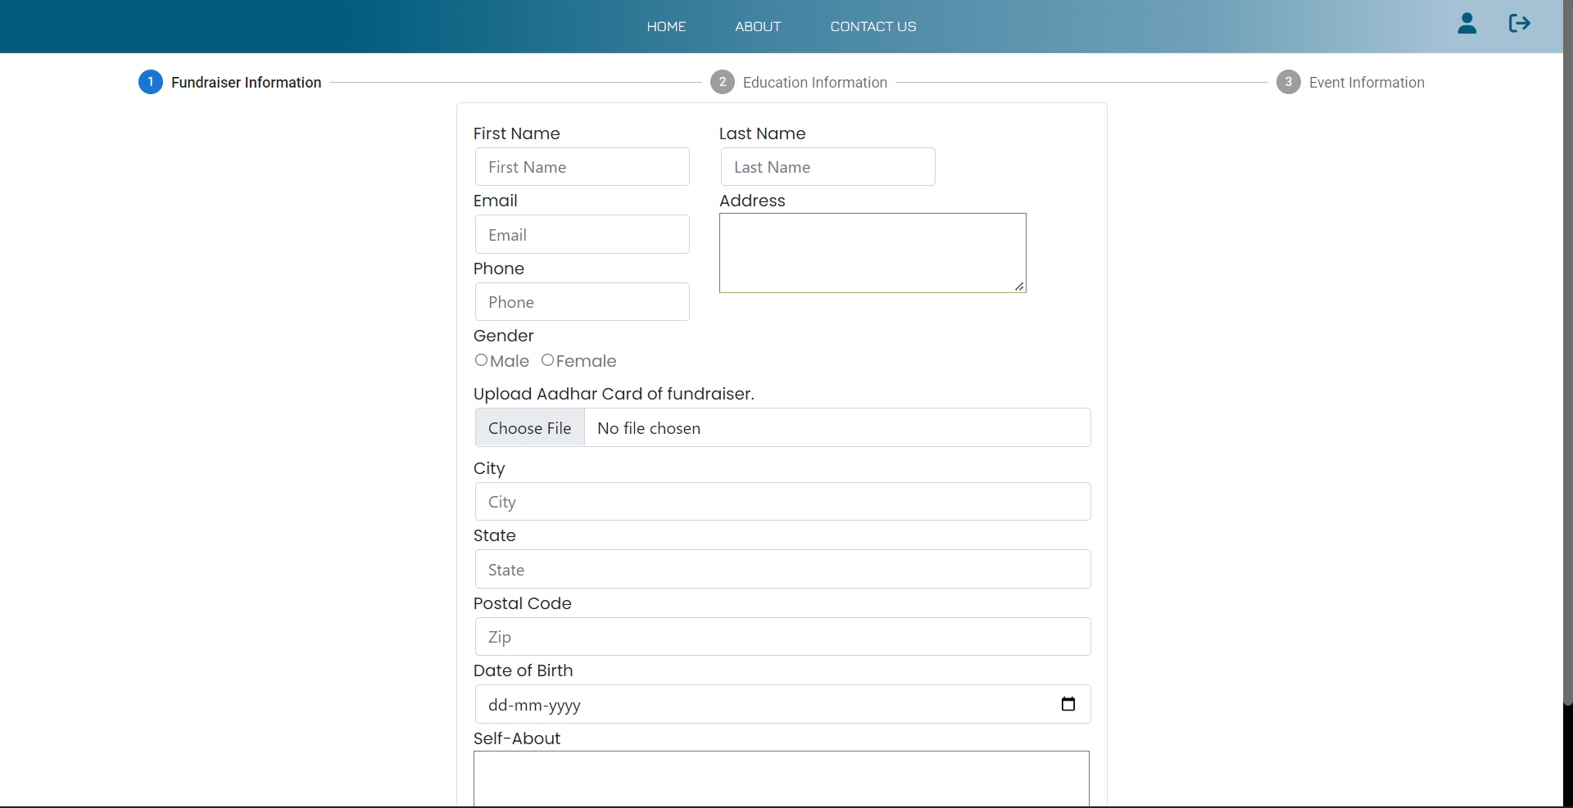
Experimental results
New Fundraising Form
Listing of Fundraising in homepage

Slide 12
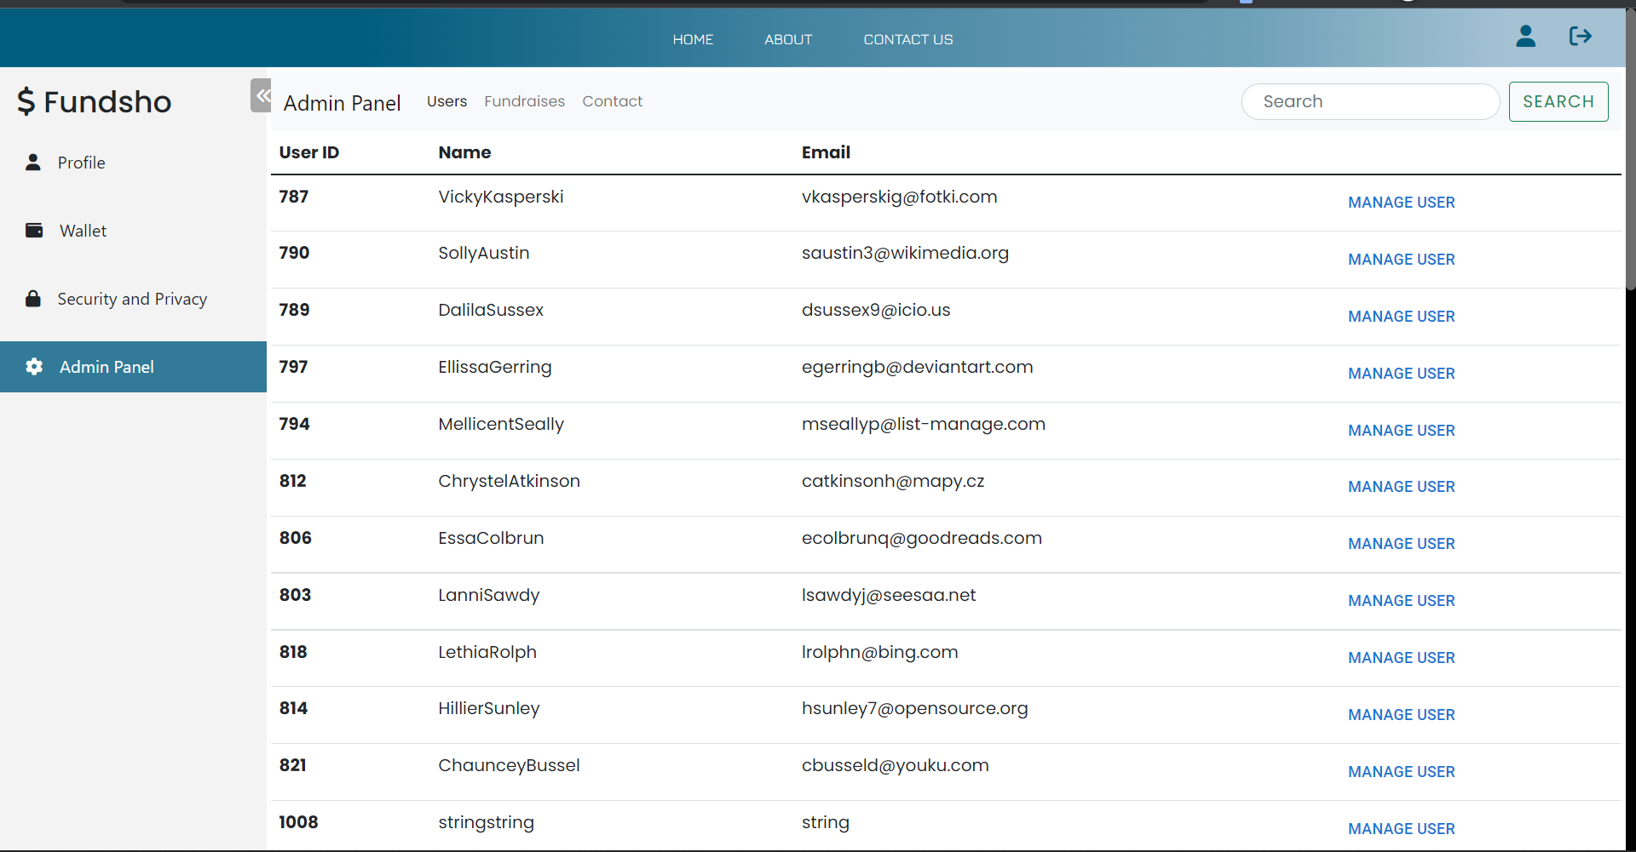
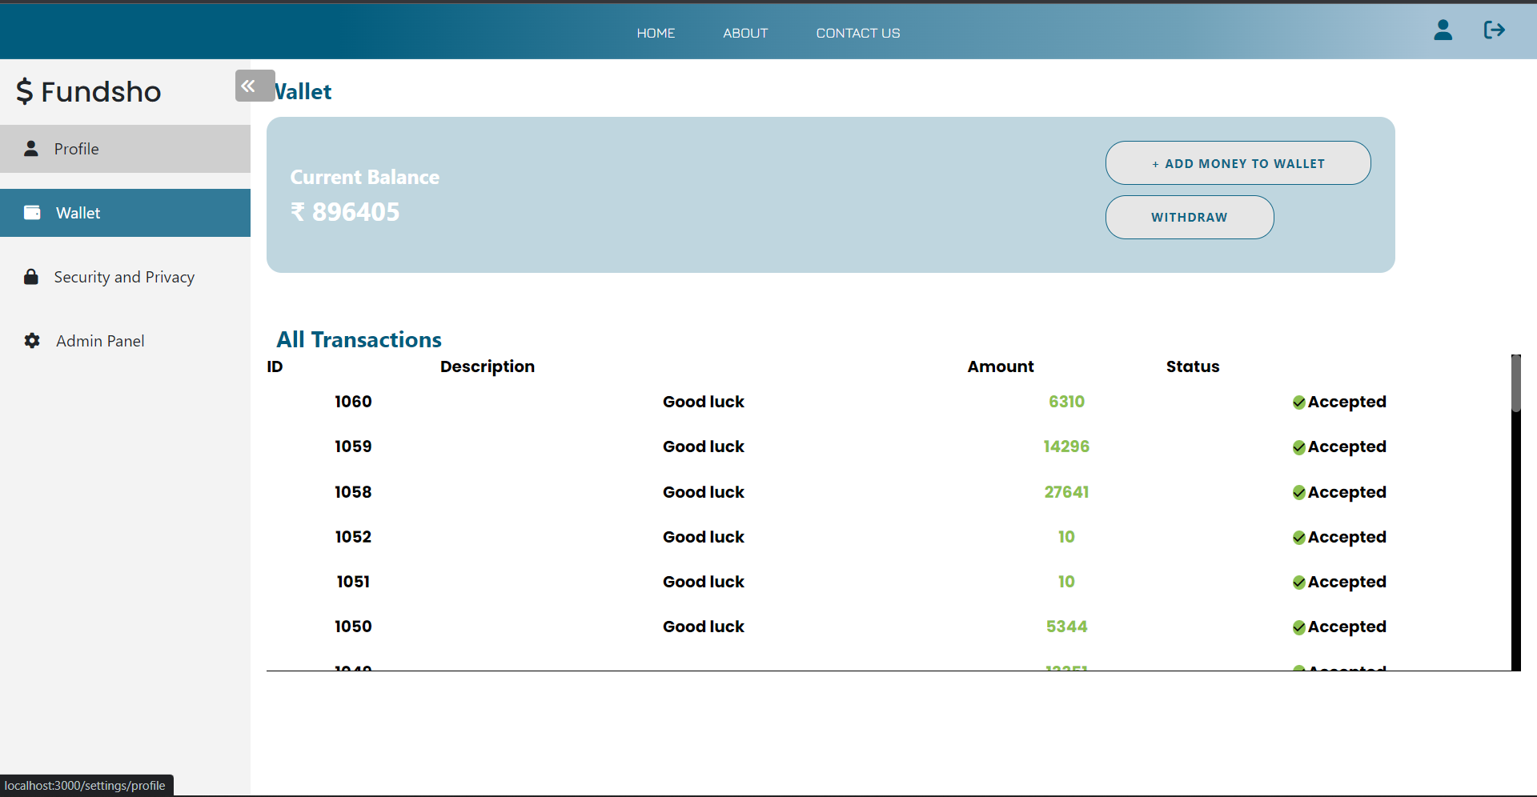
Experimental results
Wallet of users
Admin Panel

Slide 13
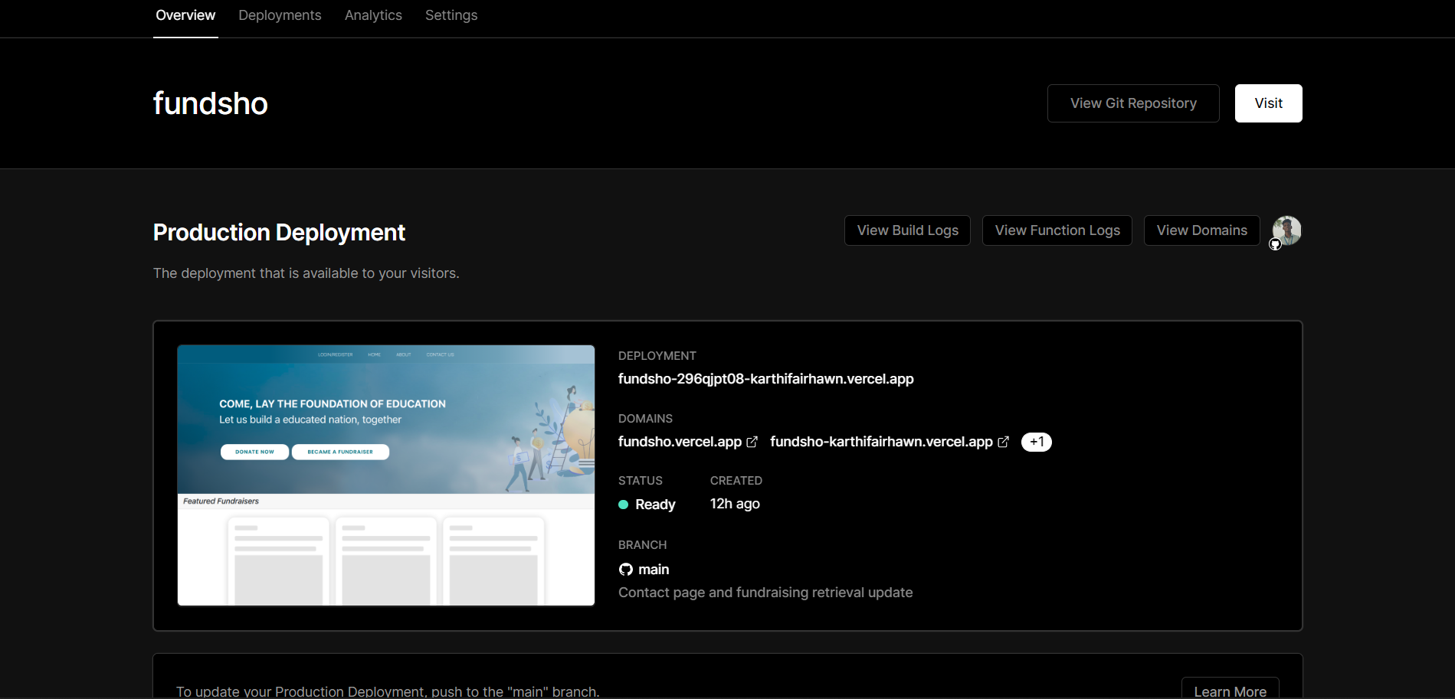
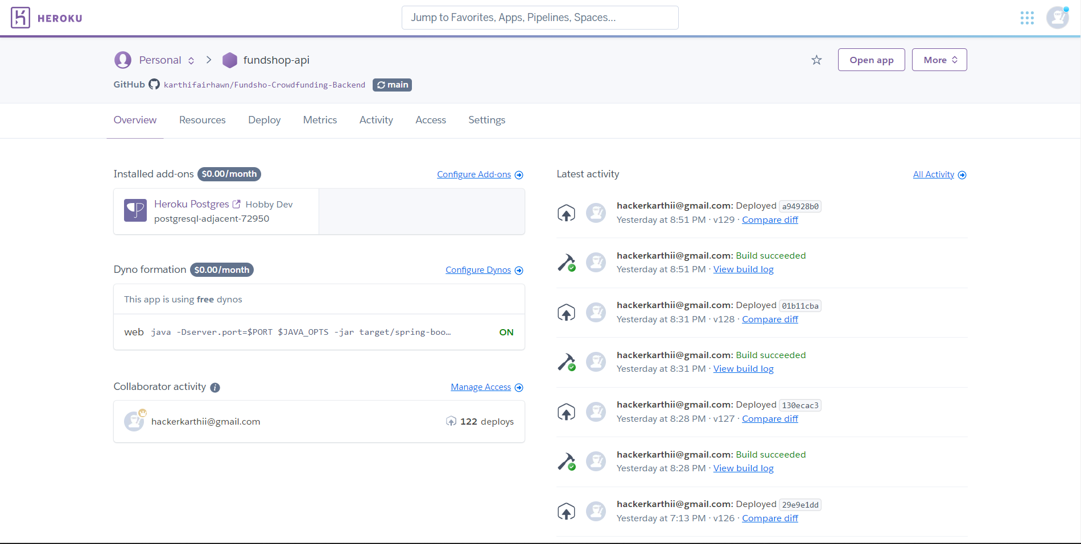
Experimental results
HEROKU API DEPLOYEMENT STATUS
VERCEL DEPLOYEMENT STATUS

Slide 14
conclusion
Crowd Fundraising is the best way to light up students' journey with great help from colleagues of the student, also with the enhanced technical features like inbuilt wallet and things the fund transfer will be so fast. Crowdfunding showed the best result in a lot of surveys made, so here with the help of the next-level features included in application, it will help in progressive the performance. The reference and surveys made on crowdfunding helped a lot in the development of the application. Making awareness about crowdfunding is much easier than other analyzed solutions, once the system has been developed for decent users, we can enable it for further raising of funds.

Slide 15
reference
Zhuoxin Li & Jason A. Duan Dynamic Strategies for Successful Online Crowdfunding," Working Papers 14-09, NET Institute.- 2014
Claire Ingram, Robin Teigland and Emmanuelle Vaast Crowdfunding in Action: How Institutional Logics Encourage and Constrain Affordance Perception - 30 Nov 2017
Chen Zhou, Manpreet Gill, Qiang Liu - Empowering Education with Crowdfunding: The Role of Crowdfunded Resources and Crowd Screening November 2, 2021
Bagheri, Afsaneh, Chitsazan, Hasti, Ebrahimi, Ashkan (2019) Crowdfunding Motivations: A Focus on Donors’ Perspectives,” Technological Forecasting and Social Change, 146, 218–32.
Cachero, Paulina, Why Some School Districts Are Banning Teachers from Crowdfunding to Pay for Classroom Supplies – 2019
Dai, Hengchen, Zhang, Dennis J, “Prosocial Goal Pursuit in Crowdfunding: Evidence from Kickstarter,” Journal of Marketing Research, 56 (3), 498–517 – 2019 [7]Gao, Qiang, Lin, Mingfeng, Wu, D.J, “Educational Crowdfunding and Student Performance: An Empirical Study,” Information Systems Research, 32 (1), 53–71. – 2021

Slide 16
reference
Jacobson, Linda , “Requests on Education Crowdfunding Site ‘Exceptionally High,’” Education Dive -July 26 2018.
Kim, Chul, Kannan, P.K., Trusov, Michael, Ordanini, Andrea , “Modeling Dynamics in Crowdfunding,” Marketing Science, 39 (2), 339–65 – 2020 20
Mollick, Ethan , “The Dynamics of Crowdfunding: An Exploratory Study,” Journal of Business Venturing, 29 (1), 1–16 2014.
React developer documentation - https://reactjs.org/docs/getting-started.html
Spring boot framework developer documentation - https://docs.spring.io/springboot/docs/current/reference/htmlsingle/

Slide 17

Thank you!
Fundsho.karthifairhawn.in
github.com/karthifairhawn/Fundsho-Crowdfunding-Backend

